Slide 1
The Urantia Book
Paper 105 Deity and Reality
Paper 105 - Video study group link part 1
Paper 105 - Video study group link part 2
Paper 105 - Video study group link part 3
Paper 104 - Growth of the Trinity Concept

Slide 2
We would like to give a special thanks to Don Estes for the use of the information from his Chart The Origin, History and Destiny of Universe Reality. We would also like to thank the creator of Encyclopedia Urantia for the use of his slides from that web site.

Slide 3
Paper 105 Deity and Reality AUDIO VERSION
^{105:0.1} ^{(1152.1)} To even high orders of universe intelligences infinity is only partially comprehensible, and the finality of reality is only relatively understandable. The human mind, as it seeks to penetrate the eternity-mystery of the origin and destiny of all that is called real, may helpfully approach the problem by conceiving eternity-infinity as an almost limitless ellipse which is produced by one absolute cause, and which functions throughout this universal circle of endless diversification, ever seeking some absolute and infinite potential of destiny.

Slide 5
Appendix III - Deity Relationships
(A simplified overview of Deity Relationships. The Gods may be seen individually or collectively as different aspects of the One God. Also known as the three Absolutes) Existential Deity
The I Am (Source of all existential and experiential Deity) I am., I Am That. I Am That I Am.
The Deity Absolute (The Qualified Absolute ) Absolute The absolute level had no beginning. It is endless, timeless, and contains no space. The absolute transcends time, space, infinity, eternity, and the Ultimate. Absolute of potentiality; activator of potentials, 1 0f 7 Absolutes of Infinity (105:3.6). Limitless, timeless, spaceless, boundless, and measureless truly infinite 106:7.3,9. The Qualified Absolute 0:11.6 Unifies with Unqualified Absolute in Universal Absolute 0:3.11 Majeston created by reaction in 17:2.2-6 Member of triodity of potentiality 104:5.4(1151;4) Overcontrols all material reality 56:1.2(637;4) | The Universal Absolute An Absolute of potentiality 115:3.8, An inevitability 0:11.10 final function of Trinity? 56:9.3, Infinite Upholder; I AM self-associative 105:2.8, Limitless, timeless, spaceless, boundless, and measureless truly infinite 106:7.3, energy proves existence of 42:0.1. Functions and actions of Universal Absolute: Alternate opposing processions of space levels part of gravity technique of 12:4.16, Compensates tension between ever-existent and uncompleted 0:11.2, Makes material universes cosmically possible 0:11.12-13, may be activated by 2nd experiential Trinity 106:5.1, member of Trinity of Trinities 56:9.5, member of triodity of potentiality 104:5.4(1151;4) physical controllers may be reactive to 29:3.11(324;1) triunity membership 104:4Unqualified Absolute and Deity Absolute unified in 0:3.11, | The Unqualified Absolute Existential things simply are. The Unqualified Absolute is existential. a positive reality 0:11.8 An Absolute of potentiality 115:3.8, Devoid of personality 0:11.7 Infinite Capacity; I AM static-reactive 105:2.10 Limitless, timeless, spaceless, boundless, and measureless truly infinite 105:3.7, Repository of static potentials, uncreated universes 0:11.4, Revealer, regulator, and repository of all that has Paradise as source 11:8.9, Totality of nonpersonal, extradivine, and undeified reality 0:11.7-9, Unpredictable in reactions 12:6.6-7 Unrevealed cosmic infinity of I AM; an Absolute of Infinity 0:11.1, Emergent energy must be liberated from 16:4.12 Matter subject to cosmic overcontrol of 21:2.12, May be activated by 2nd experiential Trinity 106:5.1, Member of triodity of potentiality 104:5.4, Master Force Organizers manipulate primordial space-forces of 12:4.6, Outer space is domain of 12:2.1

Slide 6
Qualified Absolute
(Revealed Spiritual Absolute)
The Deity Absolute is that potential which was segregated from total, infinite reality by the freewill choice of the Universal Father, and within which all divinity activities -- existential and experiential -- take place. This is the Qualified Absolute in contradistinction to the Unqualified Absolute; but the Universal Absolute is superadditive to both in the encompassment of all absolute potential

Slide 7
Universal Absolute
(Associative Resolving Absolute)
The Universal Absolute, we logically deduce, was inevitable in the Universal Father's absolute freewill act of differentiating universe realities into deified and undeified -- personalizable and nonpersonalizable -- values. The Universal Absolute is the Deity phenomenon indicative of the resolution of the tension created by the freewill act of thus differentiating universe reality, and functions as the associative co-ordinator of these sum totals of existential potentialities.
P15:1, 0:11.11 The tension-presence of the Universal Absolute signifies the adjustment of differential between deity reality and undeified reality inherent in the separation of the dynamics of freewill divinity from the statics of unqualified infinity.
P15:2, 0:11.12 Always remember: Potential infinity is absolute and inseparable from eternity. Actual infinity in time can never be anything but partial and must therefore be nonabsolute; neither can infinity of actual personality be absolute except in unqualified Deity. And it is the differential of infinity potential in the Unqualified Absolute and the Deity Absolute that eternalizes the Universal Absolute, thereby making it cosmically possible to have material universes in space and spiritually possible to have finite personalities in time.
P15:3, 0:11.13 The finite can coexist in the cosmos along with the Infinite only because the associative presence of the Universal Absolute so perfectly equalizes the tensions between time and eternity, finity and infinity, reality potential and reality actuality, Paradise and space, man and God. Associatively the Universal Absolute constitutes the identification of the zone of progressing evolutional reality existent in the time-space, and in the transcended time-space, universes of subinfinite Deity manifestation.

Slide 8
Unqualified Absolute
(Unrevealed Physical Absolute)
Unqualified Absolute unifies with Deity Absolute in Universal Absolute 0:3.11 The Unqualified Absolute is nonpersonal, extradivine, and undeified. The Unqualified Absolute is therefore devoid of personality, divinity, and all creator prerogatives. Neither fact nor truth, experience nor revelation, philosophy nor absonity are able to penetrate the nature and character of this Absolute without universe qualification.
Let it be made clear that the Unqualified Absolute is a positive reality pervading the grand universe and, apparently, extending with equal space presence on out into the force activities and prematerial evolutions of the staggering stretches of the space regions beyond the seven superuniverses. The Unqualified Absolute is not a mere negativism of philosophic concept predicated on the assumptions of metaphysical sophistries concerning the universality, dominance, and primacy of the unconditioned and the unqualified. The Unqualified Absolute is a positive universe overcontrol in infinity; this overcontrol is space-force unlimited but is definitely conditioned by the presence of life, mind, spirit, and personality, and is further conditioned by the will-reactions and purposeful mandates of the Paradise Trinity.

Slide 9
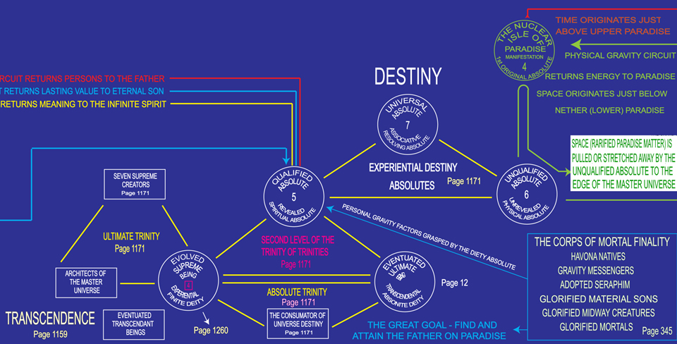

Slide 10
^{105:0.2} ^{(1152.2)} When the mortal intellect attempts to grasp the concept of reality totality, such a finite mind is face to face with infinity-reality; reality totality is infinity and therefore can never be fully comprehended by any mind that is subinfinite in concept capacity.

Slide 11
^{105:0.3} ^{(1152.3)} The human mind can hardly form an adequate concept of eternity existences, and without such comprehension it is impossible to portray even our concepts of reality totality. Nevertheless, we may attempt such a presentation, although we are fully aware that our concepts must be subjected to profound distortion in the process of translation-modification to the comprehension level of mortal mind.

Slide 12
1. The Philosophic Concept of the I AM AUDIO VERSION
^{105:1.1} ^{(1152.4)} Absolute primal causation in infinity the philosophers of the universes attribute to the Universal Father functioning as the infinite, the eternal, and the absolute I AM.

Slide 14
^{105:1.2} ^{(1152.5)} There are many elements of danger attendant upon the presentation to the mortal intellect of this idea of an infinite I AM since this concept is so remote from human experiential understanding as to involve serious distortion of meanings and misconception of values. Nevertheless, the philosophic concept of the I AM does afford finite beings some basis for an attempted approach to the partial comprehension of absolute origins and infinite destinies. But in all our attempts to elucidate the genesis and fruition of reality, let it be made clear that this concept of the I AM is, in all personality meanings and values, synonymous with the First Person of Deity, the Universal Father of all personalities. But this postulate of the I AM is not so clearly identifiable in undeified realms of universal reality.

Slide 15
^{105:1.3} ^{(1152.6)} The I AM is the Infinite; the I AM is also infinity. From the sequential, time viewpoint, all reality has its origin in the infinite I AM, whose solitary existence in past infinite eternity must be a finite creature's premier philosophic postulate. The concept of the I AM connotes unqualified infinity, the undifferentiated reality of all that could ever be in all of an infinite eternity.

Slide 16
^{105:1.4} ^{(1153.1)} As an existential concept the I AM is neither deified nor undeified, neither actual nor potential, neither personal nor impersonal, neither static nor dynamic. No qualification can be applied to the Infinite except to state that the I AM is. The philosophic postulate of the I AM is one universe concept which is somewhat more difficult of comprehension than that of the Unqualified Absolute.

Slide 17
The Unqualified Absolute
The Unqualified Absolute
Existential things simply are. The Unqualified Absolute is existential. a positive reality 0:11.8 An Absolute of potentiality 115:3.8, Devoid of personality 0:11.7 Infinite Capacity; I AM static-reactive 105:2.10 Limitless, timeless, spaceless, boundless, and measureless truly infinite 105:3.7, Repository of static potentials, uncreated universes 0:11.4, Revealer, regulator, and repository of all that has Paradise as source 11:8.9, Totality of nonpersonal, extradivine, and undeified reality 0:11.7-9, Unpredictable in reactions 12:6.6-7 Unrevealed cosmic infinity of I AM; an Absolute of Infinity 0:11.1, Emergent energy must be liberated from 16:4.12 Matter subject to cosmic overcontrol of 21:2.12, May be activated by 2nd experiential Trinity 106:5.1,
Member of triodity of potentiality 104:5.4, Master Force Organizers manipulate primordial space-forces of 12:4.6, Outer space is domain of 12:2.1

Slide 18
^{105:1.5} ^{(1153.2)} To the finite mind there simply must be a beginning, and though there never was a real beginning to reality, still there are certain source relationships which reality manifests to infinity. The prereality, primordial, eternity situation may be thought of something like this: At some infinitely distant, hypothetical, past-eternity moment, the I AM may be conceived as both thing and no thing, as both cause and effect, as both volition and response. At this hypothetical eternity moment there is no differentiation throughout all infinity. Infinity is filled by the Infinite; the Infinite encompasses infinity. This is the hypothetical static moment of eternity; actuals are still contained within their potentials, and potentials have not yet appeared within the infinity of the I AM. But even in this conjectured situation we must assume the existence of the possibility of self-will.

Slide 19
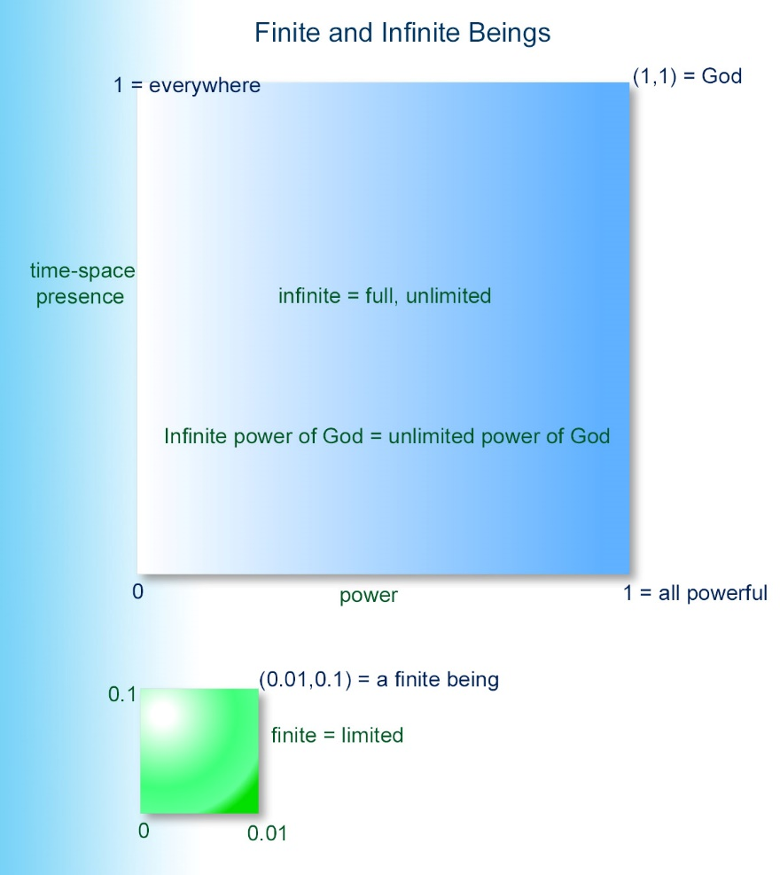

Slide 20
^{105:1.6} ^{(1153.3)} Ever remember that man's comprehension of the Universal Father is a personal experience. God, as your spiritual Father, is comprehensible to you and to all other mortals; but your experiential worshipful concept of the Universal Father must always be less than your philosophic postulate of the infinity of the First Source and Center, the I AM. When we speak of the Father, we mean God as he is understandable by his creatures both high and low, but there is much more of Deity which is not comprehensible to universe creatures. God, your Father and my Father, is that phase of the Infinite which we perceive in our personalities as an actual experiential reality, but the I AM ever remains as our hypothesis of all that we feel is unknowable of the First Source and Center. And even that hypothesis probably falls far short of the unfathomed infinity of original reality.

Slide 21
^{105:1.7} ^{(1153.4)} The universe of universes, with its innumerable host of inhabiting personalities, is a vast and complex organism, but the First Source and Center is infinitely more complex than the universes and personalities which have become real in response to his willful mandates. When you stand in awe of the magnitude of the master universe, pause to consider that even this inconceivable creation can be no more than a partial revelation of the Infinite.

Slide 22
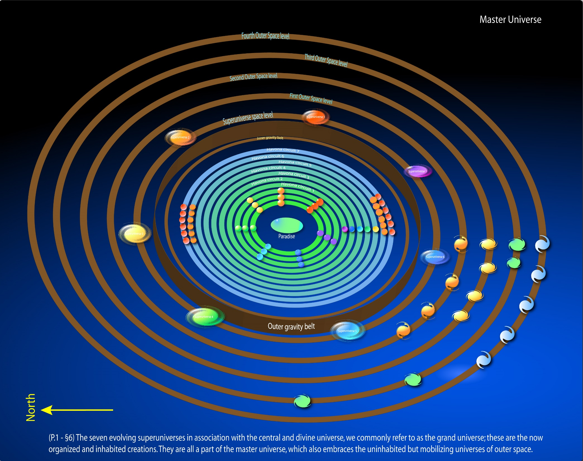

Slide 23
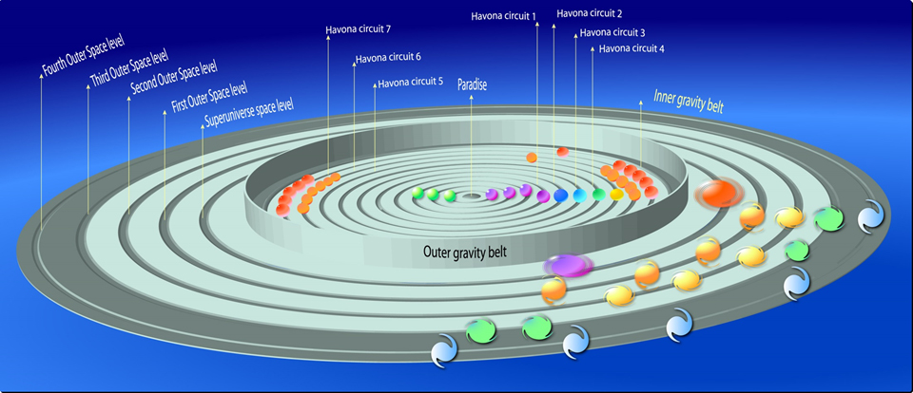

Slide 24
^{105:1.8} ^{(1153.5)} Infinity is indeed remote from the experience level of mortal comprehension, but even in this age on Urantia your concepts of infinity are growing, and they will continue to grow throughout your endless careers stretching onward into future eternity. Unqualified infinity is meaningless to the finite creature, but infinity is capable of self-limitation and is susceptible of reality expression to all levels of universe existences. And the face which the Infinite turns toward all universe personalities is the face of a Father, the Universal Father of love.

Slide 25
2. The I AM as Triune and as Sevenfold AUDIO VERSION
^{105:2.1} ^{(1153.6)} In considering the genesis of reality, ever bear in mind that all absolute reality is from eternity and is without beginning of existence. By absolute reality we refer to the three existential persons of Deity, the Isle of Paradise, and the three Absolutes. These seven realities are co-ordinately eternal, notwithstanding that we resort to time-space language in presenting their sequential origins to human beings.

Slide 26
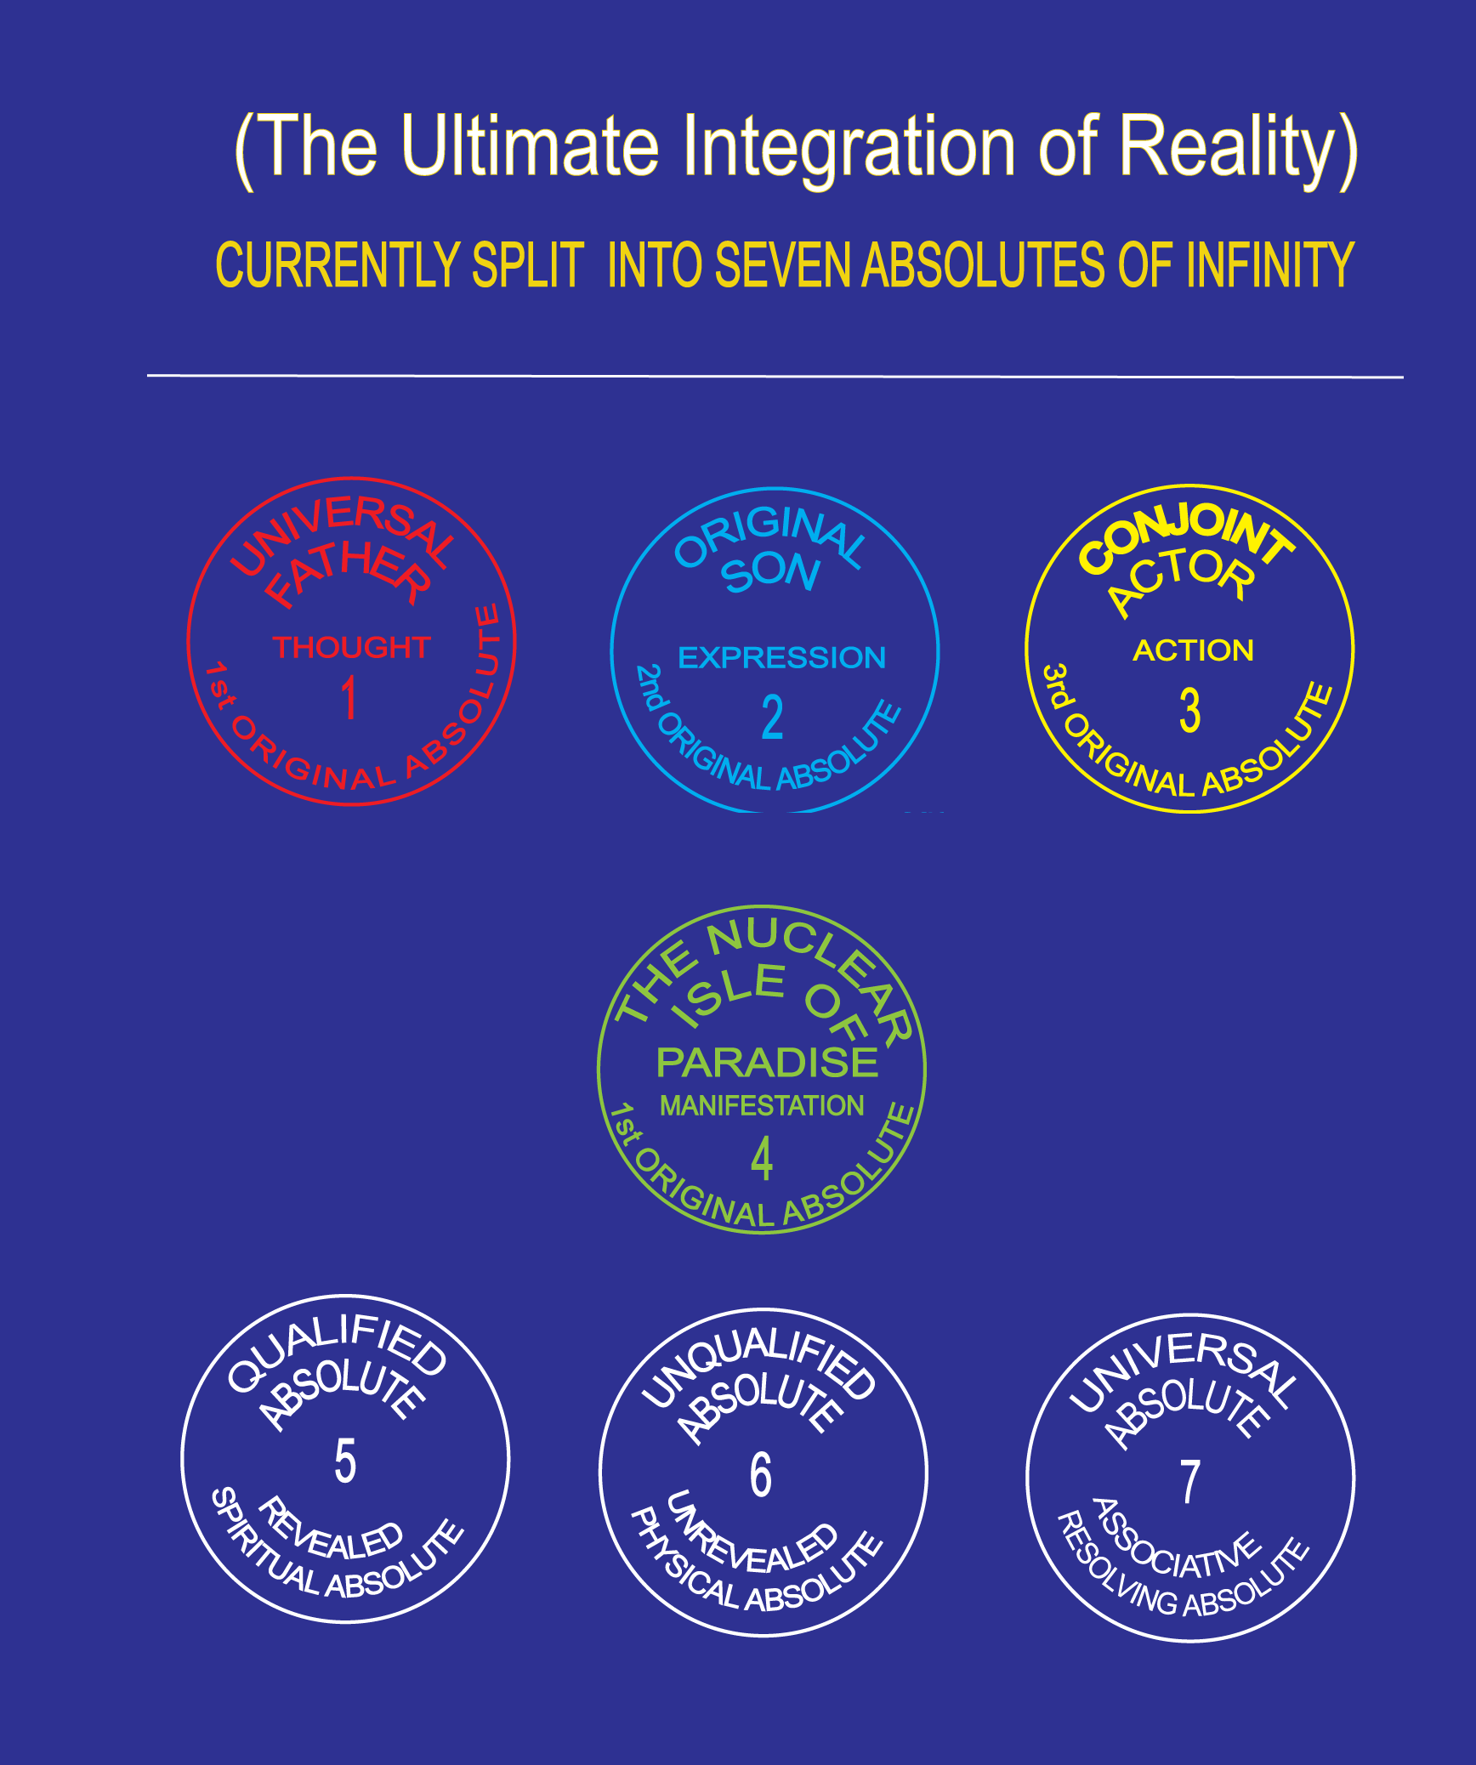

Slide 27
^{105:2.2} ^{(1154.1)} In following the chronological portrayal of the origins of reality, there must be a postulated theoretical moment of " first " volitional expression and " first " repercussional reaction within the I AM. In our attempts to portray the genesis and generation of reality, this stage may be conceived as the self-differentiation of The Infinite One from The Infinitude, but the postulation of this dual relationship must always be expanded to a triune conception by the recognition of the eternal continuum of The Infinity, the I AM.

Slide 28
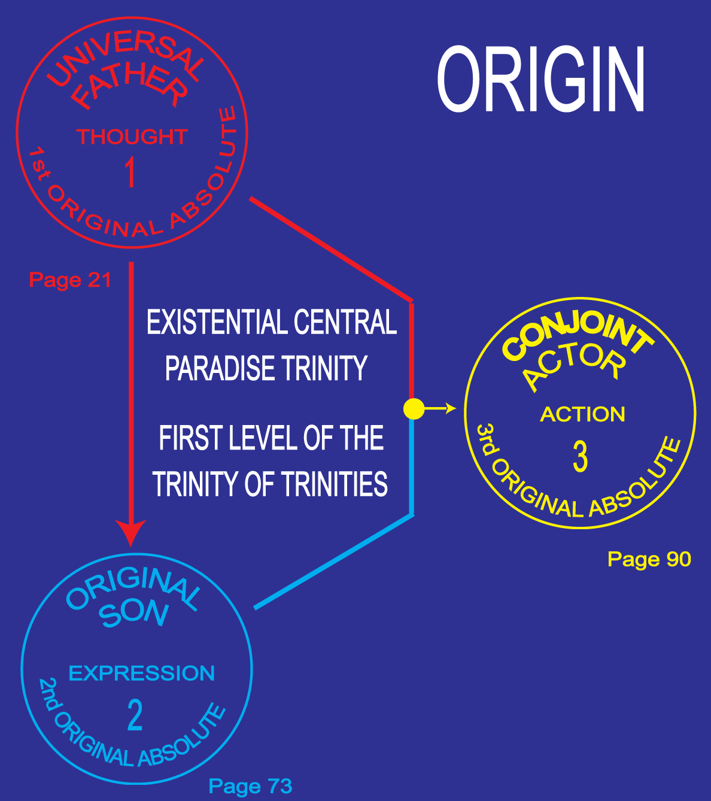

Slide 29
^{105:2.3} ^{(1154.2)} This self-metamorphosis of the I AM culminates in the multiple differentiation of deified reality and of undeified reality, of potential and actual reality, and of certain other realities that can hardly be so classified. These differentiations of the theoretical monistic I AM are eternally integrated by simultaneous relationships arising within the same I AM—the prepotential, preactual, prepersonal, monothetic prereality which, though infinite, is revealed as absolute in the presence of the First Source and Center and as personality in the limitless love of the Universal Father.

Slide 30
^{105:2.4} ^{(1154.3)} By these internal metamorphoses the I AM is establishing the basis for a sevenfold self-relationship. The philosophic (time) concept of the solitary I AM and the transitional (time) concept of the I AM as triune can now be enlarged to encompass the I AM as sevenfold. This sevenfold—or seven phase—nature may be best suggested in relation to the Seven Absolutes of Infinity:

Slide 31
^{105:2.5} ^{(1154.4)} 1. The Universal Father. I AM father of the Eternal Son. This is the primal personality relationship of actualities. The absolute personality of the Son makes absolute the fact of God's fatherhood and establishes the potential sonship of all personalities. This relationship establishes the personality of the Infinite and consummates its spiritual revelation in the personality of the Original Son. This phase of the I AM is partially experiencible on spiritual levels even by mortals who, while yet in the flesh, may worship our Father.

Slide 32
^{105:2.6} ^{(1154.5)} 2. The Universal Controller. I AM cause of eternal Paradise. This is the primal impersonal relationship of actualities, the original nonspiritual association. The Universal Father is God-as-love; the Universal Controller is God-as-pattern. This relationship establishes the potential of form—configuration—and determines the master pattern of impersonal and nonspiritual relationship—the master pattern from which all copies are made.

Slide 34
^{105:2.7} ^{(1154.6)} 3. The Universal Creator. I AM one with the Eternal Son. This union of the Father and the Son (in the presence of Paradise) initiates the creative cycle, which is consummated in the appearance of conjoint personality and the eternal universe. From the finite mortal's viewpoint, reality has its true beginnings with the eternity appearance of the Havona creation. This creative act of Deity is by and through the God of Action, who is in essence the unity of the Father-Son manifested on and to all levels of the actual. Therefore is divine creativity unfailingly characterized by unity, and this unity is the outward reflection of the absolute oneness of the duality of the Father-Son and of the Trinity of the Father-Son-Spirit.

Slide 36
^{105:2.8} ^{(1155.1)} 4. The Infinite Upholder. I AM self-associative. This is the primordial association of the statics and potentials of reality. In this relationship, all qualifieds and unqualifieds are compensated. This phase of the I AM is best understood as the Universal Absolute—the unifier of the Deity and the Unqualified Absolutes.

Slide 37
The Universal Absolute
An Absolute of potentiality 115:3.8, An inevitability 0:11.10
final function of Trinity? 56:9.3,
Infinite Upholder; I AM self-associative 105:2.8, Limitless, timeless, spaceless, boundless, and measureless truly infinite 106:7.3, energy proves existence of 42:0.1. Functions and actions of Universal Absolute:
Alternate opposing processions of space levels part of gravity technique of 12:4.16, Compensates tension between ever-existent and uncompleted 0:11.2, Makes material universes cosmically possible 0:11.12-13, may be activated by 2nd experiential Trinity 106:5.1,
member of Trinity of Trinities 56:9.5, member of triodity of potentiality 104:5.4(1151;4)
physical controllers may be reactive to 29:3.11(324;1)
triunity membership 104:4Unqualified Absolute and Deity Absolute unified in 0:3.11,

Slide 38
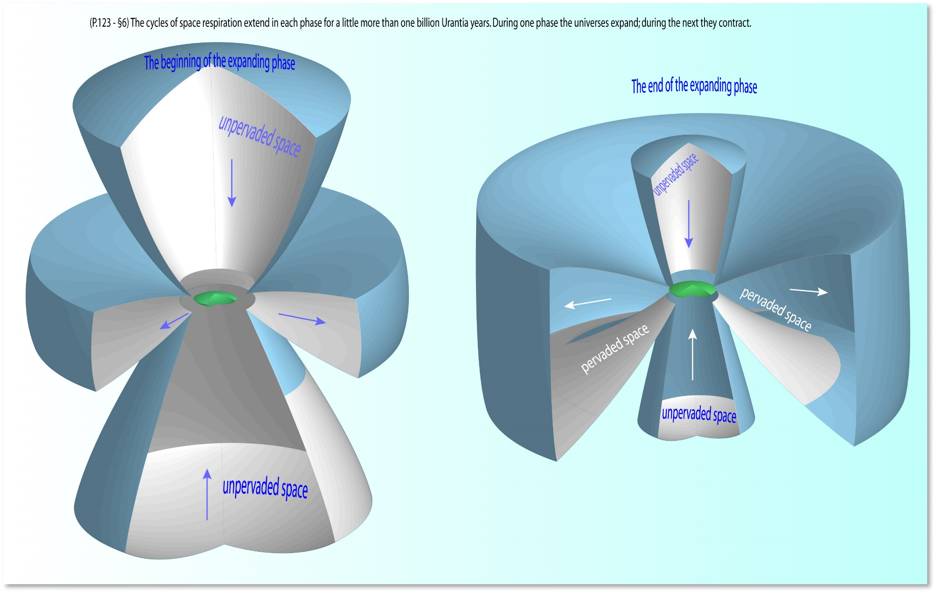

Slide 39
^{105:2.9} ^{(1155.2)} 5. The Infinite Potential. I AM self-qualified. This is the infinity bench mark bearing eternal witness to the volitional self-limitation of the I AM by virtue of which there was achieved threefold self-expression and self-revelation. This phase of the I AM is usually understood as the Deity Absolute.

Slide 40
The Deity Absolute
(The Qualified Absolute )
Absolute
The absolute level had no beginning. It is endless, timeless, and contains no space. The absolute transcends time, space, infinity, eternity, and the Ultimate. Absolute of potentiality; activator of potentials, 1 0f 7 Absolutes of Infinity (105:3.6). Limitless, timeless, spaceless, boundless, and measureless truly infinite 106:7.3,9. The Qualified Absolute 0:11.6 Unifies with Unqualified Absolute in Universal Absolute 0:3.11 Majeston created by reaction in 17:2.2-6 Member of triodity of potentiality 104:5.4(1151;4)
Overcontrols all material reality 56:1.2(637;4)

Slide 41
^{105:2.10} ^{(1155.3)} 6. The Infinite Capacity. I AM static-reactive. This is the endless matrix, the possibility for all future cosmic expansion. This phase of the I AM is perhaps best conceived as the supergravity presence of the Unqualified Absolute.

Slide 42
The Unqualified Absolute
Existential things simply are. The Unqualified Absolute is existential. a positive reality 0:11.8 An Absolute of potentiality 115:3.8, Devoid of personality 0:11.7 Infinite Capacity; I AM static-reactive 105:2.10 Limitless, timeless, spaceless, boundless, and measureless truly infinite 105:3.7, Repository of static potentials, uncreated universes 0:11.4, Revealer, regulator, and repository of all that has Paradise as source 11:8.9, Totality of nonpersonal, extradivine, and undeified reality 0:11.7-9, Unpredictable in reactions 12:6.6-7 Unrevealed cosmic infinity of I AM; an Absolute of Infinity 0:11.1, Emergent energy must be liberated from 16:4.12 Matter subject to cosmic overcontrol of 21:2.12, May be activated by 2nd experiential Trinity 106:5.1,
Member of triodity of potentiality 104:5.4, Master Force Organizers manipulate primordial space-forces of 12:4.6, Outer space is domain of 12:2.1

Slide 43
^{105:2.11} ^{(1155.4)} 7. The Universal One of Infinity. I AM as I AM. This is the stasis or self-relationship of Infinity, the eternal fact of infinity-reality and the universal truth of reality-infinity. In so far as this relationship is discernible as personality, it is revealed to the universes in the divine Father of all personality—even of absolute personality. In so far as this relationship is impersonally expressible, it is contacted by the universe as the absolute coherence of pure energy and of pure spirit in the presence of the Universal Father. In so far as this relationship is conceivable as an absolute, it is revealed in the primacy of the First Source and Center; in him we all live and move and have our being, from the creatures of space to the citizens of Paradise; and this is just as true of the master universe as of the infinitesimal ultimaton, just as true of what is to be as of that which is and of what has been.

Slide 44
3. The Seven Absolutes of Infinity AUDIO VERSION
^{105:3.1} ^{(1155.5)} The seven prime relationships within the I AM eternalize as the Seven Absolutes of Infinity. But though we may portray reality origins and infinity differentiation by a sequential narrative, in fact all seven Absolutes are unqualifiedly and co-ordinately eternal. It may be necessary for mortal minds to conceive of their beginnings, but always should this conception be overshadowed by the realization that the seven Absolutes had no beginning; they are eternal and as such have always been. The seven Absolutes are the premise of reality. They have been described in these papers as follows:

Slide 46
^{105:3.2} ^{(1155.6)} 1. The First Source and Center. First Person of Deity and primal nondeity pattern, God, the Universal Father, creator, controller, and upholder; universal love, eternal spirit, and infinite energy; potential of all potentials and source of all actuals; stability of all statics and dynamism of all change; source of pattern and Father of persons. Collectively, all seven Absolutes equivalate to infinity, but the Universal Father himself actually is infinite.

Slide 47
^{105:3.3} ^{(1155.7)} 2. The Second Source and Center. Second Person of Deity, the Eternal and Original Son; the absolute personality realities of the I AM and the basis for the realization-revelation of " I AM personality. " No personality can hope to attain the Universal Father except through his Eternal Son; neither can personality attain to spirit levels of existence apart from the action and aid of this absolute pattern for all personalities. In the Second Source and Center spirit is unqualified while personality is absolute.

Slide 48
^{105:3.4} ^{(1156.1)} 3. The Paradise Source and Center. Second nondeity pattern, the eternal Isle of Paradise; the basis for the realization-revelation of " I AM force " and the foundation for the establishment of gravity control throughout the universes. Regarding all actualized, nonspiritual, impersonal, and nonvolitional reality, Paradise is the absolute of patterns. Just as spirit energy is related to the Universal Father through the absolute personality of the Mother-Son, so is all cosmic energy grasped in the gravity control of the First Source and Center through the absolute pattern of the Paradise Isle. Paradise is not in space; space exists relative to Paradise, and the chronicity of motion is determined through Paradise relationship. The eternal Isle is absolutely at rest; all other organized and organizing energy is in eternal motion; in all space, only the presence of the Unqualified Absolute is quiescent, and the Unqualified is co-ordinate with Paradise. Paradise exists at the focus of space, the Unqualified pervades it, and all relative existence has its being within this domain.

Slide 50
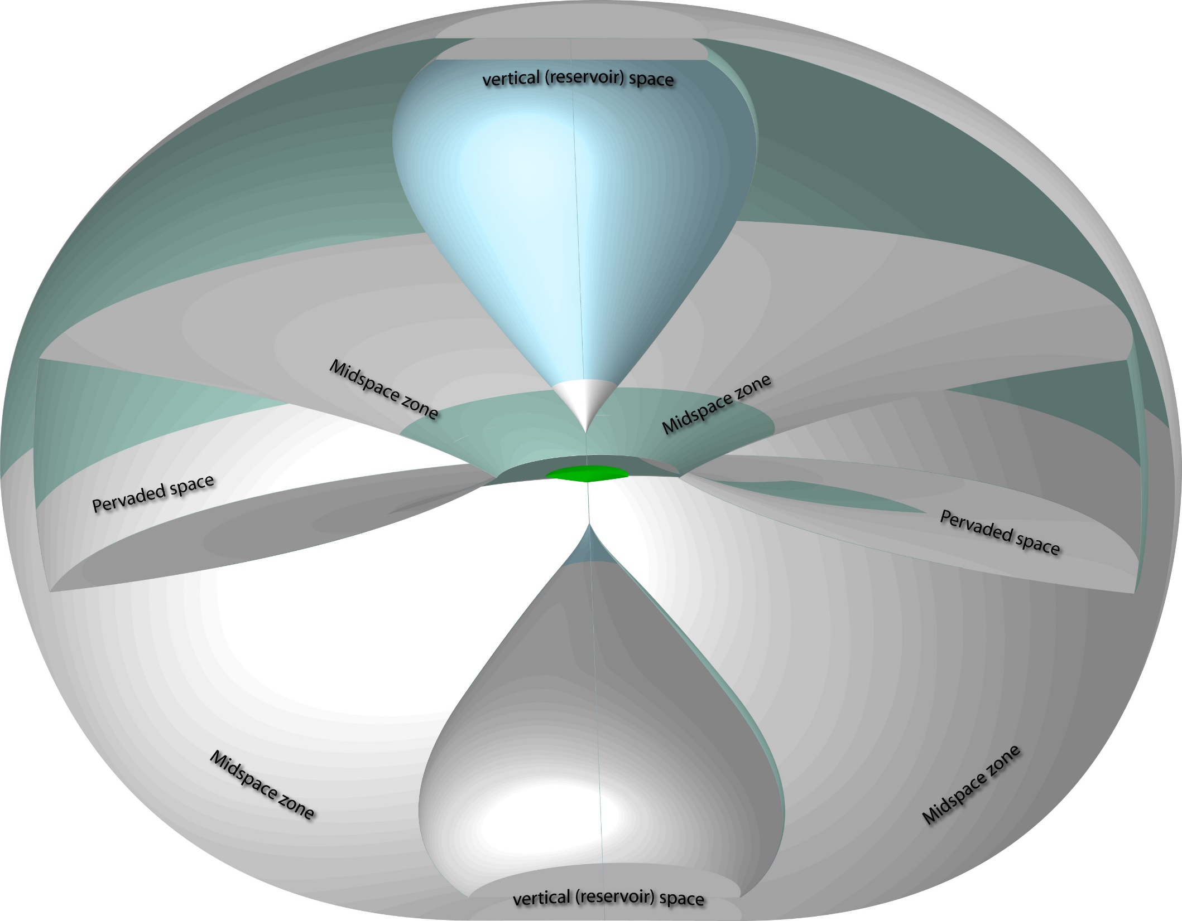

Slide 51
^{105:3.5} ^{(1156.2)} 4. The Third Source and Center. Third Person of Deity, the Conjoint Actor; infinite integrator of Paradise cosmic energies with the spirit energies of the Eternal Son; perfect co-ordinator of the motives of will and the mechanics of force; unifier of all actual and actualizing reality. Through the ministrations of his manifold children the Infinite Spirit reveals the mercy of the Eternal Son while at the same time functioning as the infinite manipulator, forever weaving the pattern of Paradise into the energies of space. This selfsame Conjoint Actor, this God of Action,is the perfect expression of the limitless plans and purposes of the Father-Son while functioning himself as the source of mind and the bestower of intellect upon the creatures of a far-flung cosmos.

Slide 52
^{105:3.6} ^{(1156.3)} 5. The Deity Absolute. The causational, potentially personal possibilities of universal reality, the totality of all Deity potential. The Deity Absolute is the purposive qualifier of the unqualified, absolute, and nondeity realities. The Deity Absolute is the qualifier of the absolute and the absolutizer of the qualified—the destiny inceptor.

Slide 53
The Deity Absolute
(The Qualified Absolute )
Absolute
The absolute level had no beginning. It is endless, timeless, and contains no space. The absolute transcends time, space, infinity, eternity, and the Ultimate. Absolute of potentiality; activator of potentials, 1 0f 7 Absolutes of Infinity (105:3.6). Limitless, timeless, spaceless, boundless, and measureless truly infinite 106:7.3,9. The Qualified Absolute 0:11.6 Unifies with Unqualified Absolute in Universal Absolute 0:3.11 Majeston created by reaction in 17:2.2-6 Member of triodity of potentiality 104:5.4(1151;4)
Overcontrols all material reality 56:1.2(637;4)

Slide 54
^{105:3.7} ^{(1156.4)} 6. The Unqualified Absolute. Static, reactive, and abeyant; the unrevealed cosmic infinity of the I AM; totality of nondeified reality and finality of all nonpersonal potential. Space limits the function of the Unqualified, but the presence of the Unqualified is without limit, infinite. There is a concept periphery to the master universe, but the presence of the Unqualified is limitless; even eternity cannot exhaust the boundless quiescence of this nondeity Absolute.

Slide 55
The Unqualified Absolute
Existential things simply are. The Unqualified Absolute is existential. a positive reality 0:11.8 An Absolute of potentiality 115:3.8, Devoid of personality 0:11.7 Infinite Capacity; I AM static-reactive 105:2.10 Limitless, timeless, spaceless, boundless, and measureless truly infinite 105:3.7, Repository of static potentials, uncreated universes 0:11.4, Revealer, regulator, and repository of all that has Paradise as source 11:8.9, Totality of nonpersonal, extradivine, and undeified reality 0:11.7-9, Unpredictable in reactions 12:6.6-7 Unrevealed cosmic infinity of I AM; an Absolute of Infinity 0:11.1, Emergent energy must be liberated from 16:4.12 Matter subject to cosmic overcontrol of 21:2.12, May be activated by 2nd experiential Trinity 106:5.1,
Member of triodity of potentiality 104:5.4, Master Force Organizers manipulate primordial space-forces of 12:4.6, Outer space is domain of 12:2.1

Slide 56
^{105:3.8} ^{(1156.5)} 7. The Universal Absolute. Unifier of the deified and the undeified; co-relater of the absolute and the relative. The Universal Absolute (being static, potential, and associative) compensates the tension between the ever-existent and the uncompleted.

Slide 57
The Universal Absolute
An Absolute of potentiality 115:3.8, An inevitability 0:11.10
final function of Trinity? 56:9.3,
Infinite Upholder; I AM self-associative 105:2.8, Limitless, timeless, spaceless, boundless, and measureless truly infinite 106:7.3, energy proves existence of 42:0.1. Functions and actions of Universal Absolute:
Alternate opposing processions of space levels part of gravity technique of 12:4.16, Compensates tension between ever-existent and uncompleted 0:11.2, Makes material universes cosmically possible 0:11.12-13, may be activated by 2nd experiential Trinity 106:5.1,
member of Trinity of Trinities 56:9.5, member of triodity of potentiality 104:5.4(1151;4)
physical controllers may be reactive to 29:3.11(324;1)
triunity membership 104:4Unqualified Absolute and Deity Absolute unified in 0:3.11,

Slide 58
^{105:3.9} ^{(1156.6)} The Seven Absolutes of Infinity constitute the beginnings of reality. As mortal minds would regard it, the First Source and Center would appear to be antecedent to all absolutes. But such a postulate, however helpful, is invalidated by the eternity co-existence of the Son, the Spirit, the three Absolutes, and the Paradise Isle.

Slide 59
^{105:3.10} ^{(1157.1)} It is a truth that the Absolutes are manifestations of the I AM-First Source and Center; it is a fact that these Absolutes never had a beginning but are co-ordinate eternals with the First Source and Center. The relationships of absolutes in eternity cannot always be presented without involving paradoxes in the language of time and in the concept patterns of space. But regardless of any confusion concerning the origin of the Seven Absolutes of Infinity, it is both fact and truth that all reality is predicated upon their eternity existence and infinity relationships.

Slide 60
4. Unity, Duality, and Triunity AUDIO VERSION
^{105:4.1} ^{(1157.2)} The universe philosophers postulate the eternity existence of the I AM as the primal source of all reality. And concomitant therewith they postulate the self-segmentation of the I AM into the primary self-relationships—the seven phases of infinity. And simultaneous with this assumption is the third postulate—the eternity appearance of the Seven Absolutes of Infinity and the eternalization of the duality association of the seven phases of the I AM and these seven Absolutes.

Slide 61
^{105:4.2} ^{(1157.3)} The self-revelation of the I AM thus proceeds from static self through self-segmentation and self-relationship to absolute relationships, relationships with self-derived Absolutes. Duality becomes thus existent in the eternal association of the Seven Absolutes of Infinity with the sevenfold infinity of the self-segmented phases of the self-revealing I AM. These dual relationships, eternalizing to the universes as the seven Absolutes, eternalize the basic foundations for all universe reality.

Slide 62
^{105:4.3} ^{(1157.4)} It has been sometime stated that unity begets duality, that duality begets triunity, and that triunity is the eternal ancestor of all things. There are, indeed, three great classes of primordial relationships, and they are:
^{105:4.4} ^{(1157.5)} . 1 Unity relationships. Relations existent within the I AM as the unity thereof is conceived as a threefold and then as a sevenfold self-differentiation.
^{105:4.5} ^{(1157.6)} 2. Duality relationships. Relations existent between the I AM as sevenfold and the Seven Absolutes of Infinity.
^{105:4.6} ^{(1157.7)} 3. Triunity relationships. These are the functional associations of the Seven Absolutes of Infinity.

Slide 63
^{105:4.7} ^{(1157.8)} Triunity relationships arise upon duality foundations because of the inevitability of Absolute interassociation. Such triunity associations eternalize the potential of all reality; they encompass both deified and undeified reality.

Slide 64
^{105:4.8} ^{(1157.9)} The I AM is unqualified infinity as unity. The dualities eternalize reality foundations. The triunities eventuate the realization of infinity as universal function.

Slide 65
^{105:4.9} ^{(1157.10)} Pre-existentials become existential in the seven Absolutes, and existentials become functional in the triunities, the basic association of Absolutes. And concomitant with the eternalization of the triunities the universe stage is set—the potentials are existent and the actuals are present—and the fullness of eternity witnesses the diversification of cosmic energy, the outspreading of Paradise spirit, and the endowment of mind together with the bestowal of personality, by virtue of which all of these Deity and Paradise derivatives are unified in experience on the creature level and by other techniques on the supercreature level.

Slide 66
5. Promulgation of Finite Reality AUDIO VERSION
^{105:5.1} ^{(1158.1)} Just as the original diversification of the I AM must be attributed to inherent and self-contained volition, so must the promulgation of finite reality be ascribed to the volitional acts of Paradise Deity and to the repercussional adjustments of the functional triunities.

Slide 67
^{105:5.2} ^{(1158.2)} Prior to the deitization of the finite, it would appear that all reality diversification took place on absolute levels; but the volitional act promulgating finite reality connotes a qualification of absoluteness and implies the appearance of relativities.

Slide 68
^{105:5.3} ^{(1158.3)} While we present this narrative as a sequence and portray the historic appearance of the finite as a direct derivative of the absolute, it should be borne in mind that transcendentals both preceded and succeeded all that is finite. Transcendental ultimates are, in relation to the finite, both causal and consummational.

Slide 71
^{105:5.4} ^{(1158.4)} Finite possibility is inherent in the Infinite, but the transmutation of possibility to probability and inevitability must be attributed to the self-existent free will of the First Source and Center,activating all triunity associations. Only the infinity of the Father's will could ever have so qualified the absolute level of existence as to eventuate an ultimate or to create a finite.

Slide 72
^{105:5.5} ^{(1158.5)} With the appearance of relative and qualified reality there comes into being a new cycle of reality—the growth cycle—a majestic downsweep from the heights of infinity to the domain of the finite, forever swinging inward to Paradise and Deity, always seeking those high destinies commensurate with an infinity source.

Slide 73
^{105:5.6} ^{(1158.6)} These inconceivable transactions mark the beginning of universe history, mark the coming into existence of time itself. To a creature, the beginning of the finite is the genesis of reality; as viewed by creature mind, there is no actuality conceivable prior to the finite. This newly appearing finite reality exists in two original phases:

Slide 74
^{105:5.7} ^{(1158.7)} 1. Primary maximums, the supremely perfect reality, the Havona type of universe and creature.
^{105:5.8} ^{(1158.8)} 2. Secondary maximums, the supremely perfected reality, the superuniverse type of creature and creation.

Slide 75
^{105:5.9} ^{(1158.9)} These, then, are the two original manifestations: the constitutively perfect and the evolutionally perfected. The two are co-ordinate in eternity relationships, but within the limits of time they are seemingly different. A time factor means growth to that which grows; secondary finites grow; hence those that are growing must appear as incomplete in time. But these differences, which are so important this side of Paradise, are nonexistent in eternity.

Slide 76
^{105:5.10} ^{(1158.10)} We speak of the perfect and the perfected as primary and secondary maximums, but there is still another type: Trinitizing and other relationships between the primaries and the secondaries result in the appearance of tertiary maximums —things, meanings, and values that are neither perfect nor perfected yet are co-ordinate with both ancestral factors.

Slide 77
6. Repercussions of Finite Reality AUDIO VERSION
^{105:6.1} ^{(1159.1)} The entire promulgation of finite existences represents a transference from potentials to actuals within the absolute associations of functional infinity. Of the many repercussions to creative actualization of the finite, there may be cited:

Slide 78
^{105:6.2} ^{(1159.2)} 1. The deity response, the appearance of the three levels of experiential supremacy: the actuality of personal-spirit supremacy in Havona, the potential for personal-power supremacy in the grand universe to be, and the capacity for some unknown function of experiential mind acting on some level of supremacy in the future master universe.

Slide 79
^{105:6.3} ^{(1159.3)} 2. The universe response involved an activation of the architectural plans for the superuniverse space level, and this evolution is still progressing throughout the physical organization of the seven superuniverses.

Slide 80
^{105:6.4} ^{(1159.4)} 3. The creature repercussion to finite-reality promulgation resulted in the appearance of perfect beings on the order of the eternal inhabitants of Havona and of perfected evolutionary ascenders from the seven superuniverses. But to attain perfection as an evolutionary (time-creative) experience implies something other-than-perfection as a point of departure. Thus arises imperfection in the evolutionary creations. And this is the origin of potential evil. Misadaptation, disharmony, and conflict, all these things are inherent in evolutionary growth, from physical universes to personal creatures.

Slide 81
^{105:6.5} ^{(1159.5)} 4. The divinity response to the imperfection inherent in the time lag of evolution is disclosed in the compensating presence of God the Sevenfold, by whose activities that which is perfecting is integrated with both the perfect and the perfected. This time lag is inseparable from evolution, which is creativity in time. Because of it, as well as for other reasons, the almighty power of the Supreme is predicated on the divinity successes of God the Sevenfold. This time lag makes possible creature participation in divine creation by permitting creature personalities to become partners with Deity in the attainment of maximum development. Even the material mind of the mortal creature thus becomes partner with the divine Adjuster in the dualization of the immortal soul. God the Sevenfold also provides techniques of compensation for the experiential limitations of inherent perfection as well as compensating the preascension limitations of imperfection.

Slide 82
7. Eventuation of Transcendentals AUDIO VERSION
^{105:7.1} ^{(1159.6)} Transcendentals are subinfinite and subabsolute but superfinite and supercreatural. Transcendentals eventuate as an integrating level correlating the supervalues of absolutes with the maximum values of finites. From the creature standpoint, that which is transcendental would appear to have eventuated as a consequence of the finite; from the eternity viewpoint, in anticipation of the finite; and there are those who have considered it as a " pre-echo " of the finite.

Slide 83
Transcendentalers. See also reality: levels of reality: absonite reality
1000 groups of supercitizens of Paradise 31:8.1-4(350;4)
also known as absoniters 0:1.12(2;1), 55:4.31,16(627;5)
attached to Corps of Mortal Finaliters 31:8sec(350;4)
concerned with superadministration of master universe 31:8.2(350;5)
have nothing to do with superuniverses or Havona 31:8.2(350;5)
in Paradise classification 30:1.92-15(332;5)
may take place of finaliters on worlds in light and life in next universe age 55:4.31,16(627;5)
neither Creators nor creatures; ever loyal; eventuated, not created 0:1.12(2;1), 30:1.92-15(332;5), 31:8.3(350;6)
orders 30:1.93(333;1)
Architects of the Master Universe q.v.
Associate Transcendental Master Force Organizers 29:5sec(329;1)
Primary Eventuated Master Force Organizers 29:5sec(329;1)
Transcendental Recorders q.v.
Paradise arrivals fraternize with 27:2.3(300;3)
process of eventuation 30:1.92-16(332;5), 31:8.3(350;6), 31:9.10(352;3)
relationship with Solitary Messengers and Inspired Trinity Spirits 31:9.13(352;6)
senior Architect of Master Universe is chief of 31:8.4(351;1), 31:9.1(351;2)
subject to God the Ultimate 31:8.3(350;6)

Slide 84
^{105:7.2} ^{(1159.7)} That which is transcendental is not necessarily nondevelopmental, but it is superevolutional in the finite sense; neither is it nonexperiential, but it is superexperience as such is meaningful to creatures. Perhaps the best illustration of such a paradox is the central universe of perfection: It is hardly absolute—only the Paradise Isle is truly absolute in the " materialized " sense. Neither is it a finite evolutionary creation as are the seven superuniverses. Havona is eternal but not changeless in the sense of being a universe of nongrowth. It is inhabited by creatures (Havona natives) who never were actually created, for they are eternally existent. Havona thus illustrates something which is not exactly finite nor yet absolute. Havona further acts as a buffer between absolute Paradise and finite creations, still further illustrating the function of transcendentals. But Havona itself is not a transcendental—it is Havona.

Slide 85
^{105:7.3} ^{(1160.1)} As the Supreme is associated with finites, so the Ultimate is identified with transcendentals. But though we thus compare Supreme and Ultimate, they differ by something more than degree; the difference is also a matter of quality. The Ultimate is something more than a super-Supreme projected on the transcendental level. The Ultimate is all of that, but more: The Ultimate is an eventuation of new Deity realities, the qualification of new phases of the theretofore unqualified.

Slide 87
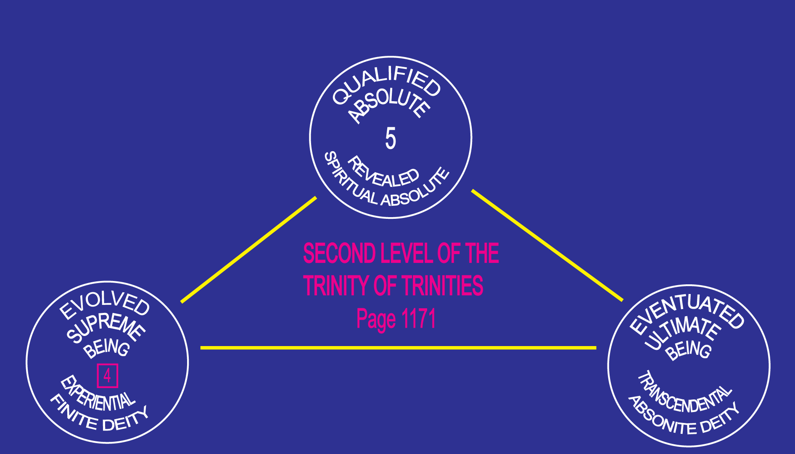

Slide 88
^{105:7.4} ^{(1160.2)} Among those realities which are associated with the transcendental level are the following:
^{105:7.5} ^{(1160.3)} 1. The Deity presence of the Ultimate.
^{105:7.6} ^{(1160.4)} 2. The concept of the master universe.
^{105:7.7} ^{(1160.5)} 3. The Architects of the Master Universe.
^{105:7.8} ^{(1160.6)} 4. The two orders of Paradise force organizers.
^{105:7.9} ^{(1160.7)} 5. Certain modifications in space potency.
^{105:7.10} ^{(1160.8)} 6. Certain values of spirit.
^{105:7.11} ^{(1160.9)} 7. Certain meanings of mind.
^{105:7.13} ^{(1160.11)} 9. Absonite qualities and realities.
^{105:7.13} ^{(1160.11)} 9. Omnipotence, omniscience, and omnipresence.
^{105:7.14} ^{(1160.12)} 10. Space.

Slide 89
^{105:7.15} ^{(1160.13)} The universe in which we now live may be thought of as existing on finite, transcendental, and absolute levels. This is the cosmic stage on which is enacted the endless drama of personality performance and energy metamorphosis.

Slide 90
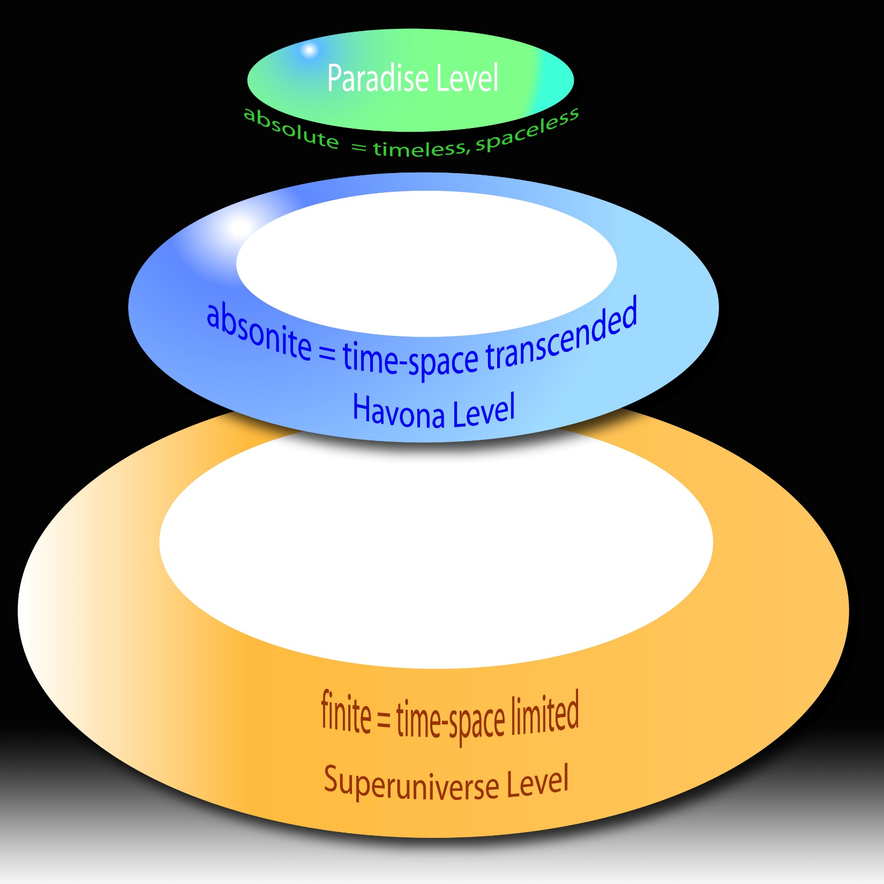

Slide 92
^{105:7.16} ^{(1160.14)} And all of these manifold realities are unified absolutely by the several triunities, functionally by the Architects of the Master Universe, and relatively by the Seven Master Spirits, the subsupreme co-ordinators of the divinity of God the Sevenfold.

Slide 93
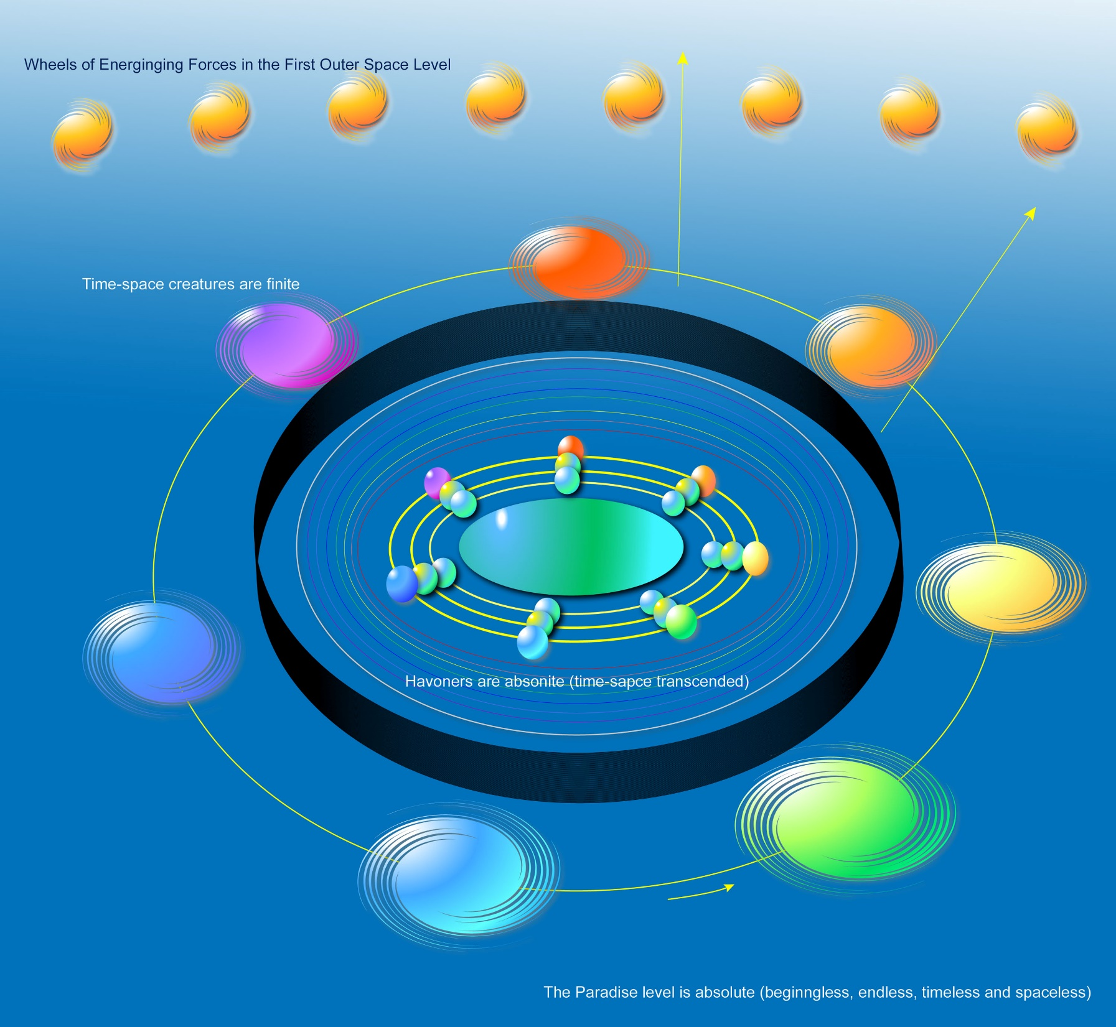

Slide 96
^{105:7.17} ^{(1160.15)} God the Sevenfold represents the personality and divinity revelation of the Universal Father to creatures of both maximum and submaximum status, but there are other sevenfold relationships of the First Source and Center which do not pertain to the manifestation of the divine spiritual ministry of the God who is spirit.

Slide 98
^{105:7.18} ^{(1160.16)} In the eternity of the past the forces of the Absolutes, the spirits of the Deities, and the personalities of the Gods stirred in response to the primordial self-will of self-existent self-will. In this universe age we are all witnessing the stupendous repercussions of the far-flung cosmic panorama of the subabsolute manifestations of the limitless potentials of all these realities. And it is altogether possible that the continued diversification of the original reality of the First Source and Center may proceed onward and outward throughout age upon age, on and on, into the faraway and inconceivable stretches of absolute infinity.
^{105:7.19} ^{(1161.1)} [Presented by a Melchizedek of Nebadon. ]

Slide 99
Paper 106 - Universe Levels of Reality

